Slide 1
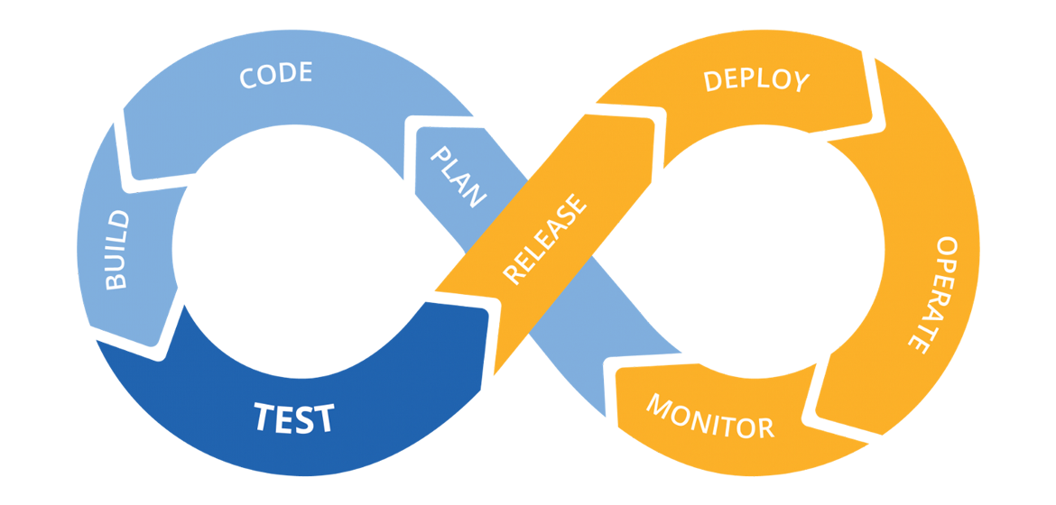

Slide 2
What is Scrum?
Scrum is a simple framework for building things (usually software) in small steps, getting feedback fast, and improving as you go.
Instead of planning everything upfront, you:
- Work in short cycles
- Deliver something usable each time
- Learn → adjust → repeat
Think: “build a little, check it, fix it, build more.”

Slide 3
The 3 Scrum Roles
1. Product Owner
Decides what to build
Owns the product backlog (the to-do list)
Prioritizes what matters most
Voice of the customer
2. Scrum Master
Makes sure Scrum is understood and followed
Removes blockers (“Why can’t you finish this?”)
Coaches the team
Facilitator, not a boss

Slide 4
3. Development Team
The people doing the work
Cross-functional (dev, QA, design, etc.)
Self-organizing
“How we do it is up to us”

Slide 5
What is a Scrum Board?
A Scrum board is a visual tool that shows:
-What work needs to be done
-What’s in progress
-What’s finished
It helps the team see the flow of work at a glance.
Think of it as a shared task dashboard for the sprint.

Slide 6
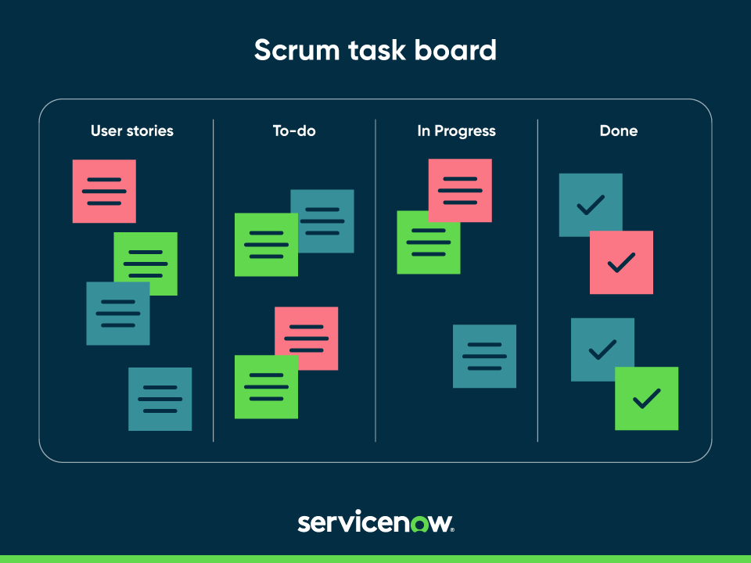

Slide 7
What Is a User Story?
A user story is a small piece of functionality written from the user’s point of view.
It describes:
Who wants something
What they want
Why they want it
Standard Format

Slide 8
As a [user], I want [something], so that [benefit].
A story describes value, not how to build it.
Example User Story
As a user, I want to reset my password, so that I can regain access if I forget it.
This is a story, not a task.

Slide 9
Breaking a Story Into Tasks
Step 1: Understand “Done”
Before creating tasks, the team agrees on what done means.
For password reset, “done” might mean:
-User can request reset
-Email is sent
-User can set a new password
-Tested
.

Slide 10
Step 2: Identify the Work
Now break the story into tasks.
As a user, I want to reset my password, so that I can regain access if I forget it.

Slide 11
Tasks
-Design password reset screen
-Create “Forgot password” link
-Build reset request API
-Generate secure reset token
-Send reset email
-Build new password form
-Validate password rules
-Update password in database
-Write unit tests
-Test end-to-end flow

Slide 12
